Slide 1
WEAREBLE Augmented reality Chaitrali Doshi Rivier University Professor: Dr. Vladimir Riabov Date of submission: 09/30/2017

Slide 2
Paper Citation
Dimitris Chatzopoulos, Carlos Bermejo, Zhanpeng Huang, Arailym Butabayeva,
Rui Zheng, Morteza Golkarifard, and Pan Hui. 2017. Hyperion: A Wearable
Augmented Reality System for Text Extraction and Manipulation in the Air.
In Proceedings of ACM Multimedia Systems, Taipei, Taiwan, June 2017
(MMSys’17), 12 pages. https://doi.org/http://dx.doi.org/10.1145/3083187.3084017

Slide 3
Motivation

Slide 4
Agenda
What is Augmented Reality?
What this paper covers?
Current Applications of Augmented Reality.
Future of Augmented Reality.
Capstone Project Idea.
Questions & Thank You.

Slide 5
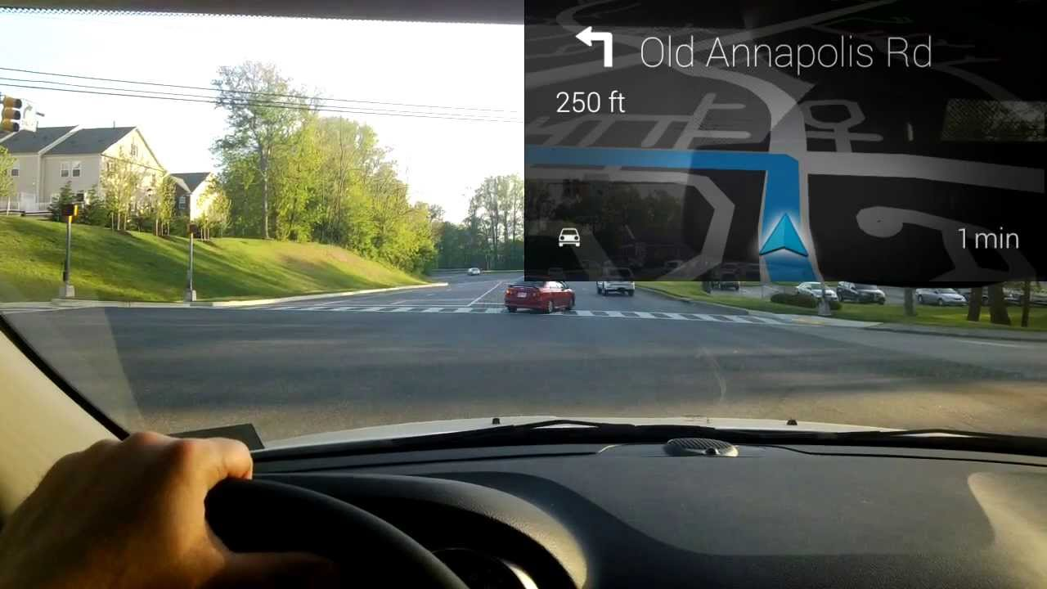
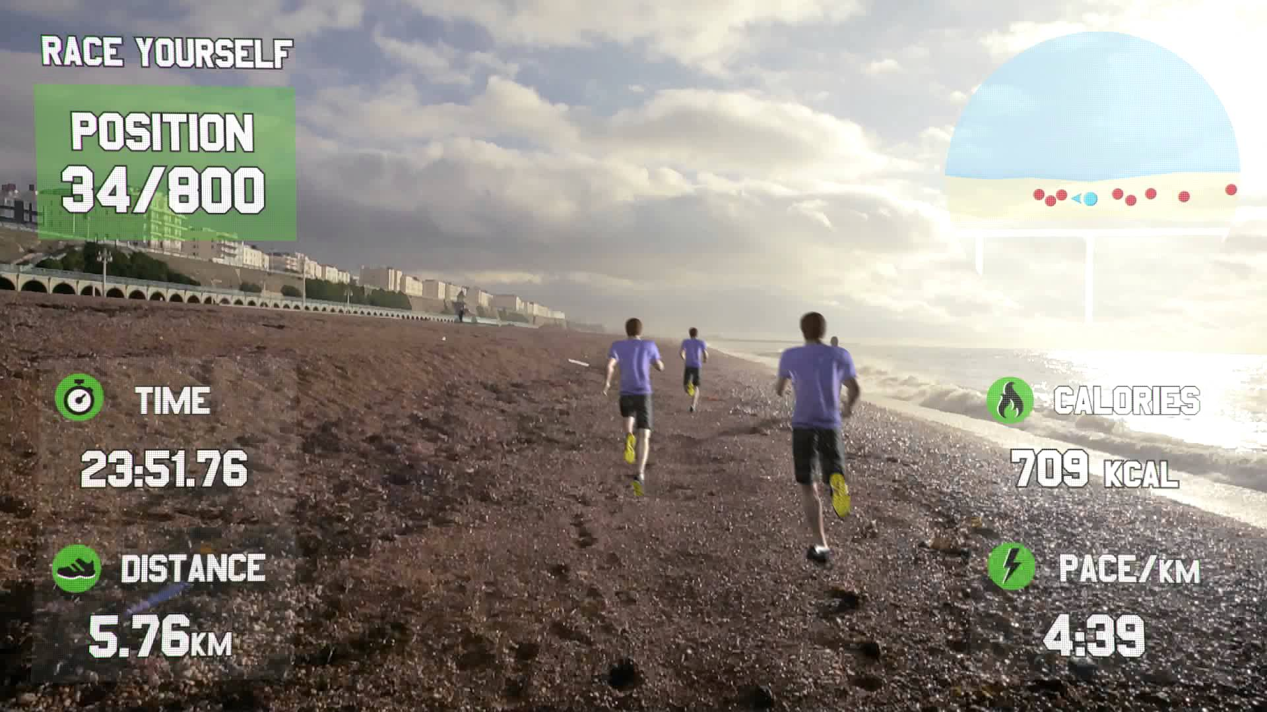
What is augmented reality?
Notes:
Augment: make (something) greater by adding to it
Augmented Reality: Bringing real and virtual world together
To provide more information, models or live actions, entertaining overlay on the real world
Augmented Learning: electronic devices to extend learner’s interaction.

Slide 6
What this paper Covers?
Introduction
Inspiration
Hyperion: Glass Development Kit(GDK) for Google Glasses
Design Principles
System Flow of Hyperion
System Architecture
System Implementation
System Performance Evaluation
Future Enhancements
Conclusion

Slide 7
Hyperion: Introduction
A Wearable Augmented Reality (WAR) system based on Google Glass to access text information in the ambient environment.
Hyperion is able to retrieve text content from users’ current view and deliver the content to them in different ways according to their context.
E.g. a tourist in London trying to explore the monuments
Notes:
Wearable Augmented Reality : Google glasses to access text in the ambient environment
Ambient: environment that completely surrounds you, but in a mellow way, like ambient music played softly throughout a restaurant
i.e. what Augmented reality does
Hyperion is also able to retrieve text from current view and deliver the info into different forms.
Example: Tourist

Slide 8
Goal & inspiration
Goal: No focus on devising new wearable device or designing new algorithm, but try to integrate existing algorithm with google glasses to provide mobile users access text information that are not accessible currently.
Inspiration: Visually Impaired people
Notes:
WHO has estimated 285 million visually impaired people over the worldwide.
39 million are blind and 246 millions have low vision

Slide 9
Hyperion: Design principles
Simplicity: Daily users & Amateur users
Relevance: Focus on how to deliver text information to users(fast & simply)
Adaptivity: Driving & help for Visually impaired people
Different Modes of Hyperion
Explore mode
Reading mode
Meeting mode
Driving mode
Notes:
Adaptivity:
Visually impaired people:
(fire & forget model) indicating direction during shopping & driving(occasionally)
(always on model) Attending classes & meeting
Alternative of Speech synthesis: UI adaption, not distracting visual attention while driving

Slide 10
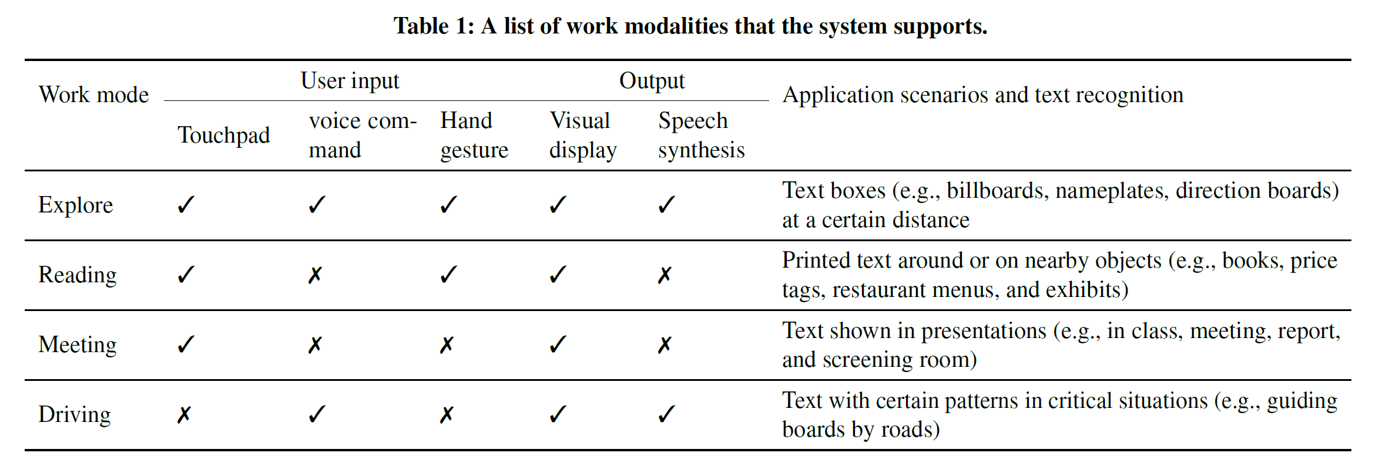
Hyperion: Work modalities chart

Slide 11
Explore mode
Notes:
Non critical situation: shopping mall, walking around campus
Uses fire and forget model
When multiple text are available shows them in blue rectangles, when pointed out the direction, explores that’s(reads or displays info)

Slide 12
Reading mode
Notes:
Conveniently access text printed on objects
Used as amplifier
The virtual lens can be moved by pointing out finger at the text.

Slide 13
Meeting mode
Notes:
When user have to access text from presentation (in a meeting or classroom sessions)
Adjust screen as per the current presentation screen display
Only hand touch modification activated, No hand gesture activated

Slide 14
Driving mode
Notes:
Designed for the drivers to acquire info on the road, driver has limited time to look for the info
Fast access traffic info with less distraction
Automatically detects some board patterns as shown in the image
Supports voice command
Display and speech synthesis are used to deliver recognized texts

Slide 15
Hyperion: Architecture & System flow
Notes:
Based on google glasses with glass development toolkit (addon on android SDK)

Slide 16
System implementation
Voice command
Speech synthesis
Hand gesture detection
Text recognition
Computation offloading

Slide 17
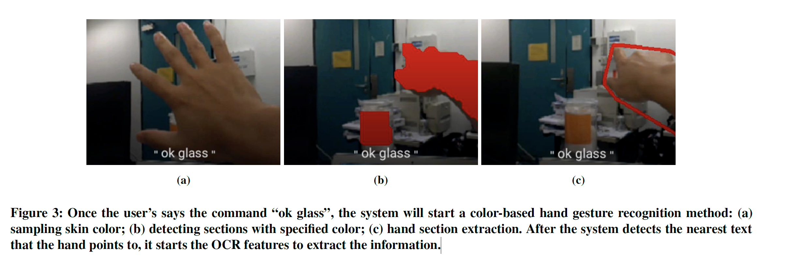
Example of hand gesture Recognition

Slide 18

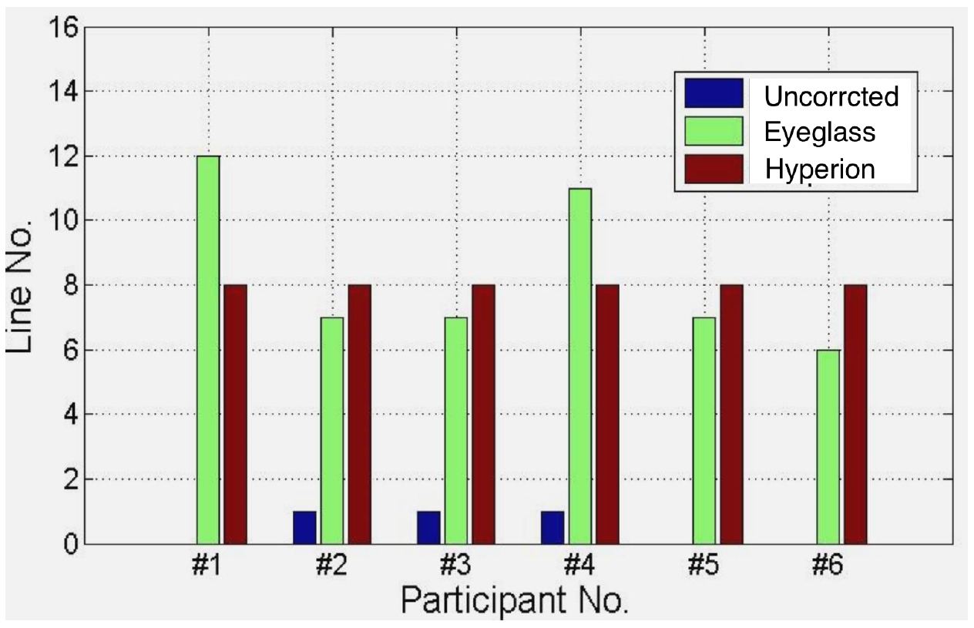

Hyperion: Performance Evaluation
Vision acuity of participants wearing no device, eyeglass, and Hyperion. Letters in higher line numbers are much smaller.

Slide 19
Hyperion FUTURE ENHANCEMENT: RETHINKING VISUAL IMPAIRMENT

Slide 20
Hyperion: CONCLUSION

Slide 21
Applications of augmented reality
Scanning a terrain (civil engineering)
location of fittings and where things go(e.g. airplane parts)
Gaming(immersive experience)
Museum/tours(information & history of Artifacts)
Architectural visualization

Slide 22
Project idea
App for Smart Glasses to Augment Reality
Researching and developing a Xamarin cross-platform Platform framework based app which can be used across Android, iOS, Windows for Smart Glasses. The focus is mainly on developing an Android based App.

Slide 23

To Be Continued…

